Slide 1
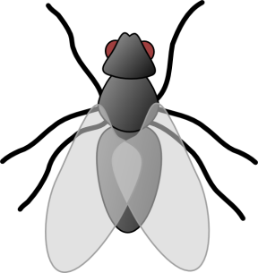
word
word
word
word
word
word
word
word

Slide 2
Flyswatter game directions
Choose two players.
Both players must face all the way to the class with their backs toward the board.
I read the definition. When done reading they may turn around and cover the word that matches my definition with their flyswatter.
The student who covers the correct word first. Uses the word in a sentence.
Choose a new player to compete against the student who got it first.
ALSO-No moving your flyswatter once you have chosen your word. DO NOT turn around before I’m finished reading the definition.

