Slide 1
Math Benchmark 1 Review

Slide 2
Which of these is true?
A) 17>19
B) 45<56
C) 78>99
D) 85<24

Slide 3
Which of these is correct?
62,456 < 61,234
63,495 > 64,678
67,456 < 68,234
66,456 > 68,556

Slide 4
James rode his motorcycle for 30 minutes, ending at 4:30 p.m. When did James start to ride?
3:50
3:45
4:15
4:00

Slide 5
Cam walked her cat for 15 minutes, beginning at 3:00. When did Cam finish walking her cat?
3:15
3:30
4:15
2:45

Slide 6
Which is the number 14,367?
Four thousand, three hundred sixty-seven
Forty thousand, three hundred sixty-seven
Fourteen thousand, three hundred sixty-seven

Slide 7
Jose took cookies out of the oven at 4:15, after they had baked for 45 minutes. What time did Jose put the cookies in the oven?
a) 3:30
b) 2:30
c) 3:15
d) 3:45

Slide 8
What is 5,392 in expanded form?
500+30+9+2
5,000+390+2
5,000+300+90+2
5,000+300+92

Slide 9
What is 30,000+2,000+400+20+1 in standard form?
32,421
34,221
32,241
31,421

Slide 10
What is two thousand, six hundred forty-seven in standard form?
2,674
2,647
2,607
2,476

Slide 11
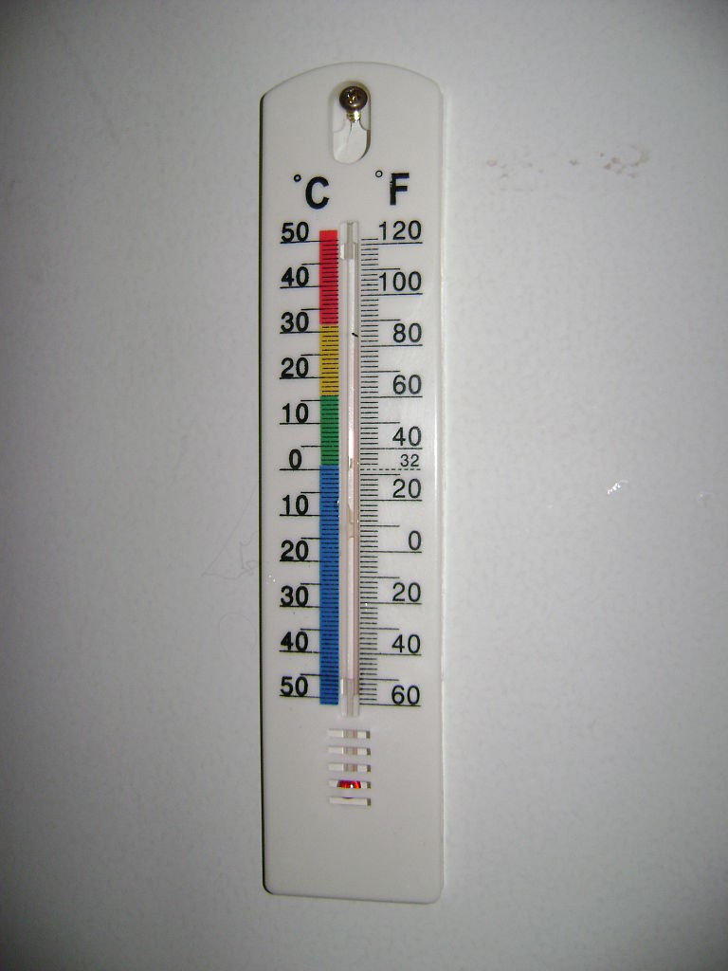
What temperature in degrees Fahrenheit does the thermometer read?

Slide 12
What temperature in degrees Fahrenheit does the thermometer read?

Slide 13
There are 19,024 movies in our video library. How should this number be written in EXPANDED FORM?

Slide 14
There are 20,467 movies in our video library. How should this number be written in EXPANDED FORM?

Slide 15
Which missing number makes this statement true?
345< 3_6
a) 1
b)2
c)5

Slide 16
Which missing number makes this statement true?
362,457 = 362,_57
a) 4
b) 5
c) 6

Slide 17
There are 14,568 people at the school. The school could hold on hundred more people. How many people can the school hold?
a) 15,568
b) 14,668
c) 14,468
d) 16,568

Slide 18
What is 100 less than 5,270?
4,270
5,370
5,170

Slide 19
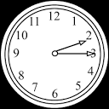
What time is shown on the the clock?

Slide 20
What time is shown on the the clock?

Slide 21
A concert sold 1,957 tickets to a show? If one thousand people want their money back, how many tickets were sold for the show?
2,957
1,057
3,957
957

Slide 22
Order these numbers from LEAST to GREATEST.
1800, 1200, 5900, 700

Slide 23
Order these numbers from GREATEST to LEAST.
4588, 6288, 6355, 5479

